Slide 1
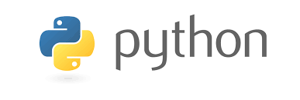
Getting started with Python Language

Slide 2
Zen of Python
>>>import this
The Zen of Python, by Tim Peters
Beautiful is better than ugly.
Explicit is better than implicit.
Simple is better than complex.
Complex is better than complicated.
Flat is better than nested.
Sparse is better than dense.
Readability counts.
Special cases aren't special enough to break the rules.
Although practicality beats purity.
Errors should never pass silently.
Unless explicitly silenced.
In the face of ambiguity, refuse the temptation to guess.
There should be one-- and preferably only one --obvious way to do it.
Although that way may not be obvious at first unless you're Dutch.
Now is better than never.
Although never is often better than *right* now.
If the implementation is hard to explain, it's a bad idea.
If the implementation is easy to explain, it may be a good idea.
Namespaces are one honking great idea -- let's do more of those!

Slide 3
Getting Started
Python features a dynamic type system and automatic memory management and supports multiple programming paradigms, including object-oriented, imperative, functional programming, and procedural styles. It has a large and comprehensive standard library.
Two major versions of Python are currently in active use:
Python 3.x is the current version and is under active development.
Python 2.x is the legacy version and will receive only security updates until 2020. No new features will be implemented. Note that many projects still use Python 2, although migrating to Python 3 is getting easier.
You can download and install either version of Python here. See Python 3 vs. Python 2 for a comparison between them

Slide 4
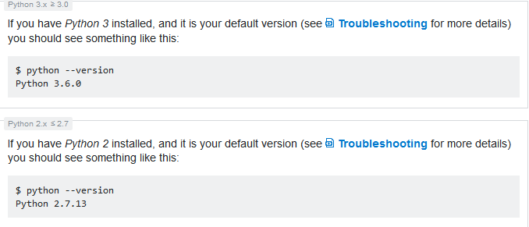
Verify if Python is installed
To confirm that Python was installed correctly, you can verify that by running the following command:
$ python –version

Slide 5
Hello, World in Python using IDLE
IDLE is a simple editor for Python, that comes bundled with Python.
How to create Hello, World program in IDLE
Open IDLE on your system of choice.
In older versions of Windows, it can be found at All Programs under the Windows menu.
In Windows 8+, search for IDLE or find it in the apps that are present in your system.
On Unix-based (including Mac) systems you can open it from the shell by typing $ idle python_file.py.
It will open a shell with options along the top.
In the shell, there is a prompt of three right angle brackets:
>>>

Slide 6
Now write the following code in the prompt:
>>> print("Hello, World")
Hit Enter.
>>> print("Hello, World")
Hello, World

Slide 7
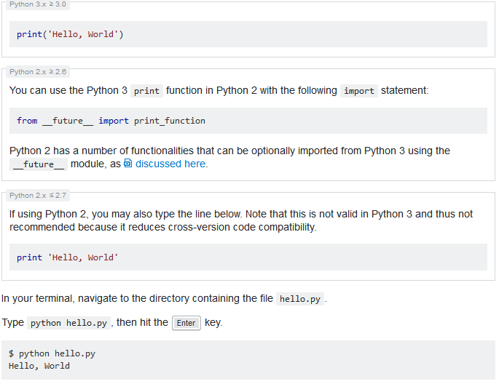
Hello World Python file
Create a new file hello.py that contains the following line:

Slide 8
Launch an interactive Python shell
By executing (running) the python command in your terminal, you are presented with an interactive Python shell. This is also known as the Python Interpreter or a REPL (for 'Read Evaluate Print Loop').
$ python
Python 2.7.12 (default, Jun 28 2016, 08:46:01)
[GCC 6.1.1 20160602] on linux
Type "help", "copyright", "credits" or "license" for more information.
>>> print 'Hello, World'
Hello, World
>>>

Slide 9
If you want to run Python 3 from your terminal, execute the command python3.
$ python3
Python 3.6.0 (default, Jan 13 2017, 00:00:00) [GCC 6.1.1 20160602] on linux
Type "help", "copyright", "credits" or "license" for more information.
>>> print('Hello, World')
Hello, World
>>>

Slide 10
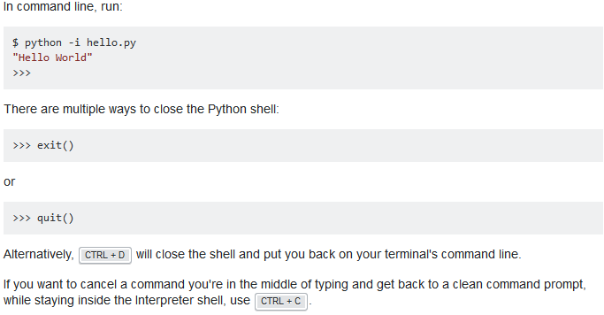
Alternatively, start the interactive prompt and load file with python -i <file.py>.

Slide 11
Other Online Shells
Various websites provide online access to Python shells. Online shells may be useful for the following purposes:
Run a small code snippet from a machine which lacks python installation(smartphones, tablets etc).
Learn or teach basic Python.
Solve online judge problems

Slide 12
Examples:
Disclaimer: documentation author(s) are not affiliated with any resources listed below.
https://www.python.org/shell/ - The online Python shell hosted by the official Python website.
https://ideone.com/ - Widely used on the Net to illustrate code snippet behavior.
https://repl.it/languages/python3 - Powerful and simple online compiler, IDE and interpreter. Code, compile, and run code in Python.
https://www.tutorialspoint.com/execute_python_online.php - Full-featured UNIX shell, and a user-friendly project explorer.
http://rextester.com/l/python3_online_compiler - Simple and easy to use IDE which shows execution time

Slide 13
Run commands as a string
Python can be passed arbitrary code as a string in the shell:
$ python -c 'print("Hello, World")'
Hello, World

Slide 14
Shells and Beyond
Package Management - The PyPA recommended tool for installing Python packages is PIP. To install, on your command line execute pip install <the package name>. For instance, pip install numpy. (Note: On windows you must add pip to your PATH environment variables. To avoid this, use python -m pip install <the package name>)

Slide 15
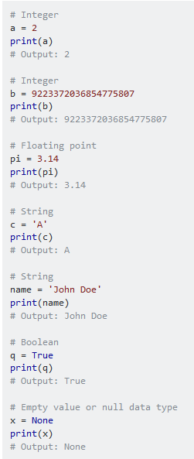
Creating variables and assigning values
To create a variable in Python, all you need to do is specify the variable name, and then assign a value to it.
<variable name> = <value>
Variable assignment works from left to right. So the following will give you an syntax error
0 = x
Output: SyntaxError: can't assign to literal
You can not use python's keywords as a valid variable name. You can see the list of keyword by:
import keyword
print(keyword.kwlist)
Notes:
import keyword
print(keyword.kwlist)
['False', 'None', 'True', 'and', 'as', 'assert', 'async', 'await', 'break', 'class', 'continue', 'def', 'del', 'elif', 'else', 'except', 'finally', 'for', 'from', 'global', 'if', 'import', 'in', 'is', 'lambda', 'nonlocal', 'not', 'or', 'pass', 'raise', 'return', 'try', 'while', 'with', 'yield']

Slide 16
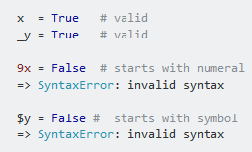


Rules for variable naming
Variables names must start with a letter or an underscore.
The remainder of your variable name may consist of letters, numbers and underscores.
Names are case sensitive.
Notes:
x = True
_x = False
__x = True
print(x, _x, __x)
True False True

Slide 17
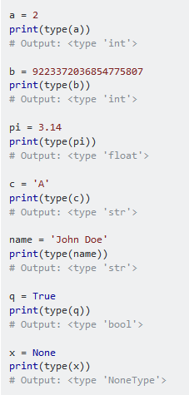
Built-in type
There's no need to specify a data type when declaring a variable in Python, the Python interpreter automatically picks the most suitable built-in type for it:
When you use = to do an assignment operation, what's on the left of = is a name for the object on the right. Finally, what = does is assign the reference of the object on the right to the name on the left.
That is:
a_name = an_object # "a_name" is now a name for the reference to the object "an_object“
if we pick pi = 3.14, then pi is a name (not the name, since an object can have multiple names) for the object 3.14

Slide 18
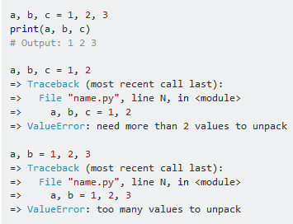

= operator
You can assign multiple values to multiple variables in one line. Note that there must be the same number of arguments on the right and left sides of the = operator:
The error in last example can be obviated by assigning remaining values to equal number of arbitrary variables.

Slide 19
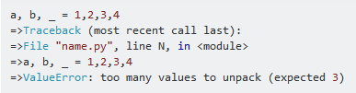

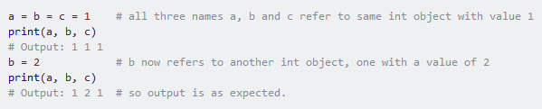
Note that the number of _ and number of remaining values must be equal. Otherwise 'too many values to unpack error' is thrown as above:
You can also assign a single value to several variables simultaneously.
When using such cascading assignment, it is important to note that all three variables a, b and c refer to the same object in memory, an int object with the value of 1.

Slide 20


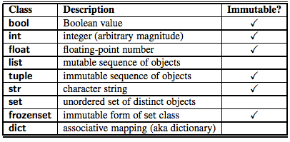
The above is also true for mutable types (like list, dict, etc.) just as it is true for immutable types (like int, string, tuple, etc.):
Things are a bit different when it comes to modifying the object:

Slide 21
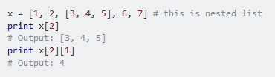
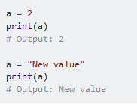
Nested lists are also valid in python. This means that a list can contain another list as an element.
Lastly, variables in Python do not have to stay the same type as which they were first defined -- you can simply use = to assign a new value to a variable, even if that value is of a different type.

Slide 22
Block Indentation
Python uses indentation (1-tab or spaces) to define control and loop constructs. This contributes to Python's readability, however, it requires the programmer to pay close attention to the use of whitespace. Thus, editor miscalibration could result in code that behaves in unexpected ways.
Python uses the colon symbol (:) and indentation for showing where blocks of code begin and end (If you come from another language, do not confuse this with somehow being related to the ternary operator). That is, blocks in Python, such as functions, loops, if clauses and other constructs, have no ending identifiers. All blocks start with a colon and then contain the indented lines below it.

Slide 23
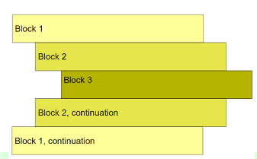
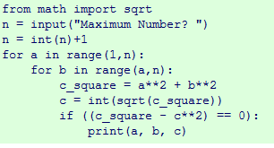

Slide 24
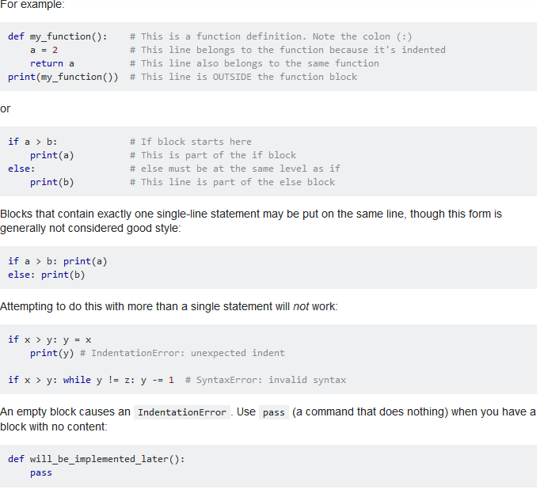

Slide 25
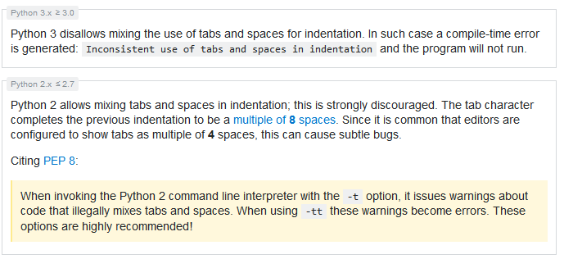
Spaces vs. Tabs
In short: always use 4 spaces for indentation. Using tabs exclusively is possible but PEP 8, the style guide for Python code, states that spaces are preferred.
Many editors have "tabs to spaces" configuration. When configuring the editor, one should differentiate between the tab character ('\t') and the Tab key.

Slide 26
Built-in Types Boolean
bool: A boolean value of either True or False. Logical operations like and, or, not can be performed on booleans.
x or y # if x is False then y otherwise x
x and y # if x is False then x otherwise y
not x # if x is True then False, otherwise True
In Python 2.x and in Python 3.x, a boolean is also an int. The bool type is a subclass of the int type and True and False are its only instances:
issubclass(bool, int) # True
isinstance(True, bool) # True
isinstance(False, bool) # True

Slide 27
Numbers
int: Integer number
a = 2 b = 100 c = 123456789 d = 38563846326424324
Integers in Python are of arbitrary sizes.
Note: in older versions of Python, a long type was available and this was distinct from int. The two have been unified.
float: Floating point number; precision depends on the implementation and system architecture, for CPython the float datatype corresponds to a C double.
a = 2.0 b = 100.e0 c = 123456789.e1
complex: Complex numbers
a = 2 + 1j b = 100 + 10j
The <, <=, > and >= operators will raise a TypeError exception when any operand is a complex number.

Slide 28
Sequences and collections
Python differentiates between ordered sequences and unordered collections (such as set and dict).
str: Character string; in Python 3 it is a unicode string, while in Python 2 it is a byte string.
unicode: In Python 3 this type does not exist, str replaces it; in Python 2 it represents an unicode encoded string.
bytes: In Python 3 this represents a string of bytes, without encoding defined; in Python 2 this is a synonym of str.
tuple: An ordered collection of n values of any type (n >= 0); supports indexing; immutable; hashable if all its members are hashable.
a = (1, 2, 3)
b = ('a', 1, 'python', (1, 2))
b[2] = 'something else' # returns a TypeError
list: An ordered collection of n values (n >= 0); not hashable; mutable.
a = [1, 2, 3]
b = ['a', 1, 'python', (1, 2), [1, 2]]
b[2] = 'something else' # allowed
set: An unordered collection of unique values.
a = {1, 2, 'a'}
reversed: A reversed order of str with reversed function
a = reversed('hello')
dict: An unordered collection of unique key-value pairs; keys must be hashable.

Slide 29
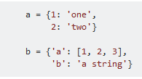
An object is hashable if it has a hash value which never changes during its lifetime (it needs a __hash__() method), and can be compared to other objects (it needs an __eq__() method). Hashable objects which compare equality must have the same hash value.

Slide 30
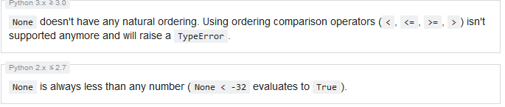
Built-in constants
In conjunction with the built-in datatypes there are a small number of built-in constants in the built-in namespace:
True: The true value of the built-in type bool
False: The false value of the built-in type bool
None: A singleton object used to signal that a value is absent.
Ellipsis or ...: used in core Python3+ anywhere and limited usage in Python2.7+ as part of array notation. numpy and related packages use this as a 'include everything' reference in arrays.
NotImplemented: a singleton used to indicate to Python that a special method doesn't support the specific arguments, and Python will try alternatives if available.
a = None # No value will be assigned. Any valid datatype can be assigned later

Slide 31
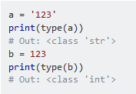
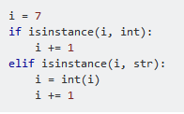

Testing the type of variables
In python, we can check the datatype of an object using the built-in function type.
In conditional statements it is possible to test the datatype with isinstance. However, it is usually not encouraged to rely on the type of the variable.
To test if something is of NoneType:

Slide 32
Converting between datatypes
You can perform explicit datatype conversion.
For example, '123' is of str type and it can be converted to integer using int function.
a = '123'
b = int(a)
Converting from a float string such as '123.456' can be done using float function.
a = '123.456'
b = float(a)
c = int(a) # ValueError: invalid literal for int() with base 10: '123.456'
d = int(b) # 123
You can also convert sequence or collection types
a = 'hello'
list(a) # ['h', 'e', 'l', 'l', 'o']
set(a) # {'o', 'e', 'l', 'h'}

Slide 33
Explicit string type at definition of literals
With one letter labels just in front of the quotes you can tell what type of string you want to define.
b'foo bar': results bytes in Python 3, str in Python 2
u'foo bar': results str in Python 3, unicode in Python 2
'foo bar': results str
r'foo bar': results so called raw string, where escaping special characters is not necessary, everything is taken verbatim as you typed
normal = 'foo\nbar' # foo # bar
escaped = 'foo\\nbar' # foo\nbar
raw = r'foo\nbar' # foo\nbar

Slide 34
Mutable and Immutable Data Types
In Python everything is an object. When define a variable like below
a = 5
We are creating an object that holds an int value 5 and tagging it with name a (the variable name) so that we can later use int value (5) with the variable name a.
Now, we re-assign a with new value 6 like below
a = 6
Here, we are modifying variable a to point to a new object 6 ie. tagging in with the same variable name a. So, it means in python we can never modify an int object rather create a new object and tag it with same name. So, int is an immutable data type.

Slide 35
Immutable Data Types::
int, long, float, complex
str
byte
tuple
Frozenset
Mutable Data Types::
bytearray
list
set
dict

Slide 36
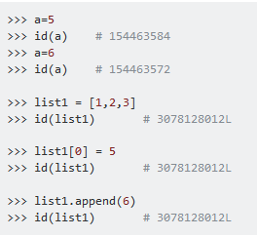
You can use id() to check the identity of object, to verify whether same object is modified or new object is created.

Slide 37
Collection Types
There are a number of collection types in Python. While types such as int and str hold a single value, collection types hold multiple values.
Lists
The list type is probably the most commonly used collection type in Python. Despite its name, a list is more like an array in other languages, mostly JavaScript. In Python, a list is merely an ordered collection of valid Python values. A list can be created by enclosing values, separated by commas, in square brackets:
int_list = [1, 2, 3]
string_list = ['abc', 'defghi']
A list can be empty:
empty_list = []
The elements of a list are not restricted to a single data type, which makes sense given that Python is a dynamic language:
mixed_list = [1, 'abc', True, 2.34, None]
A list can contain another list as its element:
nested_list = [['a', 'b', 'c'], [1, 2, 3]]

Slide 38
The elements of a list can be accessed via an index, or numeric representation of their position. Lists in Python are zero-indexed meaning that the first element in the list is at index 0, the second element is at index 1 and so on:
names = ['Alice', 'Bob', 'Craig', 'Diana', 'Eric'] print(names[0]) # Alice
print(names[2]) # Craig
Indices can also be negative which means counting from the end of the list (-1 being the index of the last element). So, using the list from the above example:
print(names[-1]) # Eric
print(names[-4]) # Bob
Lists are mutable, so you can change the values in a list:
names[0] = 'Ann'
print(names)
# Outputs ['Ann', 'Bob', 'Craig', 'Diana', 'Eric']

Slide 39
Besides, it is possible to add and/or remove elements from a list:
Append object to end of list with L.append(object), returns None.
names = ['Alice', 'Bob', 'Craig', 'Diana', 'Eric'] names.append("Sia")
print(names)
# Outputs ['Alice', 'Bob', 'Craig', 'Diana', 'Eric', 'Sia']
Add a new element to list at a specific index. L.insert(index, object)
names.insert(1, "Nikki")
print(names)
# Outputs ['Alice', 'Nikki', 'Bob', 'Craig', 'Diana', 'Eric', 'Sia']
Remove the first occurrence of a value with L.remove(value), returns None
names.remove("Bob")
print(names)
# Outputs ['Alice', 'Nikki', 'Craig', 'Diana', 'Eric', 'Sia']

Slide 40
Get the index in the list of the first item whose value is x. It will show an error if there is no such item.
name.index("Alice")
0
Count length of list
len(names)
6
count occurrence of any item in list
a = [1, 1, 1, 2, 3, 4]
a.count(1)
3
Reverse the list
a.reverse()
[4, 3, 2, 1, 1, 1]
# or
a[::-1]
[4, 3, 2, 1, 1, 1]
Remove and return item at index (defaults to the last item) with L.pop([index]), returns the item
names.pop() # Outputs 'Sia'
You can iterate over the list elements like below:
for element in my_list:
print (element)

Slide 41
Tuples
A tuple is similar to a list except that it is fixed-length and immutable. So the values in the tuple cannot be changed nor the values be added to or removed from the tuple. Tuples are commonly used for small collections of values that will not need to change, such as an IP address and port. Tuples are represented with parentheses instead of square brackets:
ip_address = ('10.20.30.40', 8080)
The same indexing rules for lists also apply to tuples. Tuples can also be nested and the values can be any valid Python valid.
A tuple with only one member must be defined (note the comma) this way:
one_member_tuple = ('Only member',) or
one_member_tuple = 'Only member', # No brackets
or just using tuple syntax
one_member_tuple = tuple(['Only member'])

Slide 42
Dictionaries
A dictionary in Python is a collection of key-value pairs. The dictionary is surrounded by curly braces. Each pair is separated by a comma and the key and value are separated by a colon. Here is an example:
state_capitals = {
'Arkansas': 'Little Rock',
'Colorado': 'Denver',
'California': 'Sacramento',
'Georgia': 'Atlanta' }
To get a value, refer to it by its key:
ca_capital = state_capitals['California']
You can also get all of the keys in a dictionary and then iterate over them:
for k in state_capitals.keys():
print('{} is the capital of {}'.format(state_capitals[k], k))
Dictionaries strongly resemble JSON syntax. The native json module in the Python standard library can be used to convert between JSON and dictionaries.

Slide 43
set
A set is a collection of elements with no repeats and without insertion order but sorted order. They are used in situations where it is only important that some things are grouped together, and not what order they were included. For large groups of data, it is much faster to check whether or not an element is in a set than it is to do the same for a list.
Defining a set is very similar to defining a dictionary:
first_names = {'Adam', 'Beth', 'Charlie'}
Or you can build a set using an existing list:
my_list = [1,2,3]
my_set = set(my_list)
Check membership of the set using in:
if name in first_names:
print(name)
You can iterate over a set exactly like a list, but remember: the values will be in a arbitrary, implementation-defined order.

Slide 44
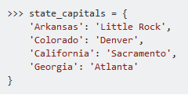
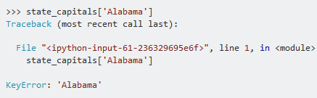

defaultdict
A defaultdict is a dictionary with a default value for keys, so that keys for which no value has been explicitly defined can be accessed without errors. defaultdict is especially useful when the values in the dictionary are collections (lists, dicts, etc) in the sense that it does not need to be initialized every time when a new key is used.
A defaultdict will never raise a KeyError. Any key that does not exist gets the default value returned.
For example, consider the following dictionary
If we try to access a non-existent key, python returns us an error as follows
Let us try with a defaultdict. It can be found in the collections module.

Slide 45



What we did here is to set a default value (Boston) in case the give key does not exist. Now populate the dict as before:
If we try to access the dict with a non-existent key, python will return us the default value i.e. Boston
and returns the created values for existing key just like a normal dictionary

Slide 46
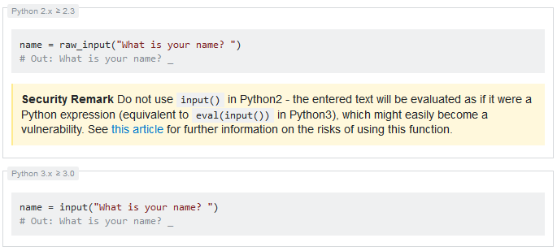
Interactive input
To get input from the user, use the input function (note: in Python 2.x, the function is called raw_input instead, although Python 2.x has its own version of input that is completely different):

Slide 47
The remainder of this example will be using Python 3 syntax.
The function takes a string argument, which displays it as a prompt and returns a string. The above code provides a prompt, waiting for the user to input.
name = input("What is your name? ")
# Out: What is your name?
If the user types "Bob" and hits enter, the variable name will be assigned to the string "Bob":
name = input("What is your name? ")
# Out: What is your name? Bob
print(name) #
Out: Bob
Note that the input is always of type str, which is important if you want the user to enter numbers. Therefore, you need to convert the str before trying to use it as a number:
x = input("Write a number:")
# Out: Write a number: 10
x / 2 # Out: TypeError: unsupported operand type(s) for /: 'str' and 'int'
float(x) / 2
# Out: 5.0

